Slide 1
Stress Testing/Holter

Slide 2
Stress Testing
Clinical test
Controlled Environment
Testing Hearts ability to respond to external stress
  Walking, cycling, climbing
2 methods
  Exercise or Chemical

Slide 3
Contraindications/Termination
Contraindications
Termination
MI <48hours
Unstable Angina
Arrhythmia that are uncontrolled
PE/Aortic Dissection or Pericarditis
CHF
Pulmonary Hypertension
Systolic BP decrease by 10mmHg
Increase in nervous systems symptoms
Poor Perfusion
  Cyanosis
Request
V-Tach
ST Elevation of 1 mm in aVR or v1

Slide 4
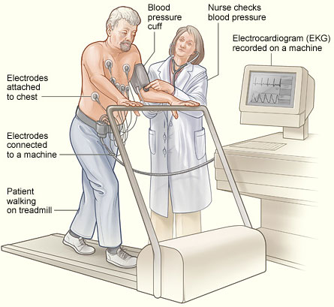

Slide 5
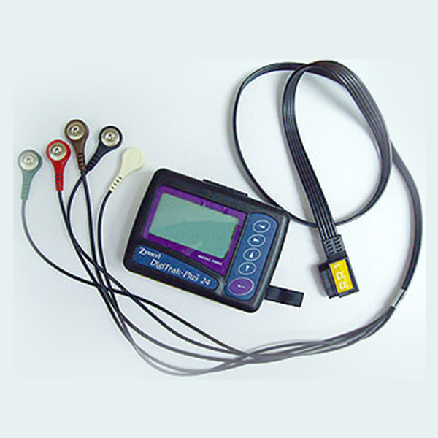
Holter Monitor
Things you can do with monitor?
  Workout?
  Shower?
  Smoke?
Electrodes my fall off, what do we do?
How long worn for?

Slide 6
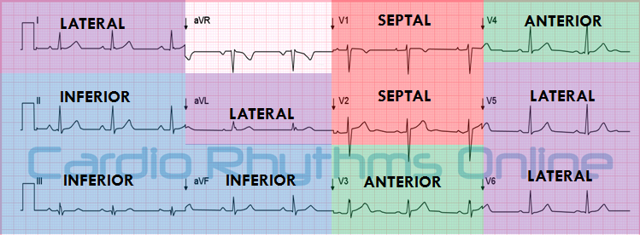
Reciprocal Leads

Slide 7
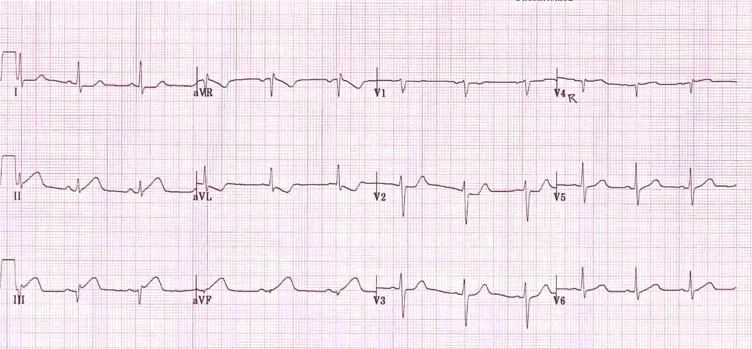
Again

Slide 8
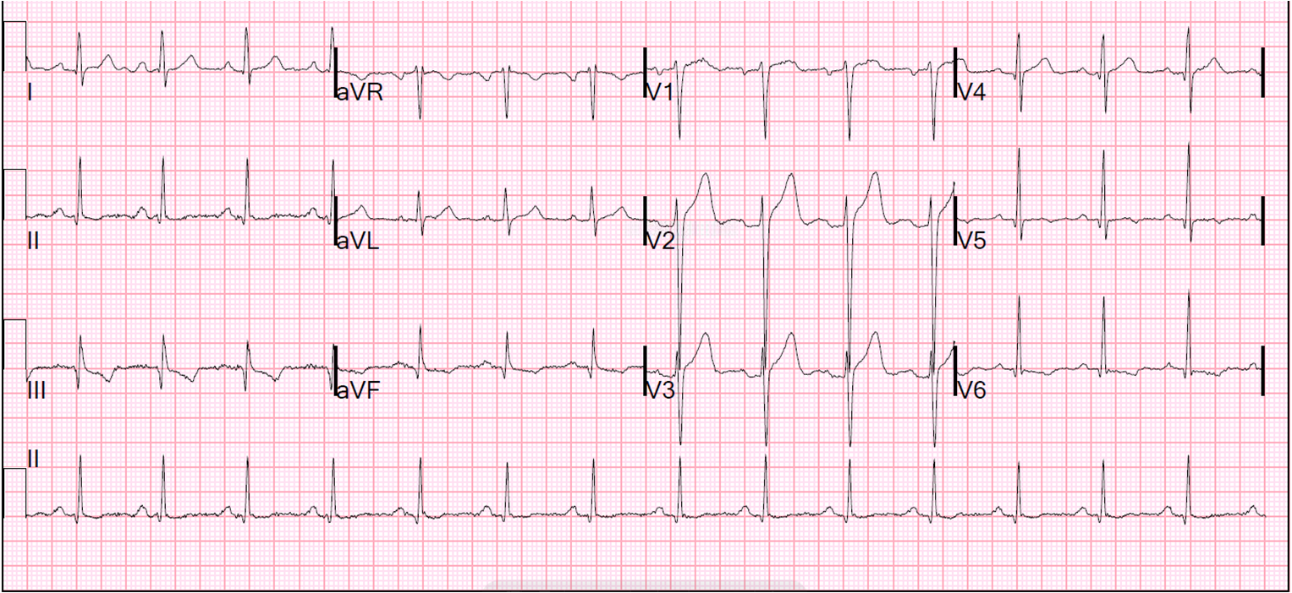
Lets Try

